Slide 1
Platform as a Service (PaaS)
PaaS (Platform as a service)
PaaS lies directly above the IaaS layer.
PaaS provides a platform to its users to design, develop, debug, test and deploy their applications.
The application s/w, their license, and management is solely responsibility of the end user.
PaaS only provides a platform or middleware to run these applications.

Slide 2
Platform as a Service (PaaS)
PaaS Components
PaaS sublayer is sub divided into two main components:
Computing platform: Refer to an OS layer that is required to run any kind of s/w over h/w.
Middleware stack: Also known as solution stack, refer to an environment build over computing platform, to support other applications.

Slide 3
Platform as a Service (PaaS)
Platform services may include the following components or more:
Operating system environment.
A web hosting environment with the complete stack (web server, servlet container, database etc.).
Secure computing environments (with all the security protocols audited and compliance laws adhered to).
Software version control platforms. For example, GIT, SVN, CVS etc.
Development environments: A platform ready with all the development tools - compiler, debuggers, test scripts etc.
Test environment with the right configuration pre-done to suit a test run

Slide 4
IaaS vs PaaS vs SaaS
A VM for PaaS carries a pre-built VM with installed operating system and middleware ready to host user applications. Whereas in IaaS, the VM provided is a virtual hardware shell. All software starting from the OS to the level of the application must be installed by the end-user.
Like IaaS, PaaS includes infrastructure—servers, storage, and networking—but also middleware, development tools, business intelligence (BI) services, database management systems, and more. PaaS is designed to support the complete web application lifecycle: building, testing, deploying, managing, and updating.
PaaS may often be confused with SaaS since middleware is also a software that is being provided as a service. However, the important difference here is that PaaS provides a software platform that is required to run and support other user software/applications.

Slide 5
Platform as a Service (PaaS)
Things to Consider before choosing PaaS
Will it support the application which we want to run.
PaaS platform must accommodate the future enhancements of the hosted application.
CSP must provide tools that would enable easy deployment of the application to be hosted on PaaS.
A user must prefer open-standards while choosing a PaaS. This will help migration of application to other CSP due to cost/performance reasons in the future.
The user needs to check that the PaaS platform must be scalable as per the application demands.
Adequate security provisions must be there in PaaS to ensure the proper data isolation.

Slide 6
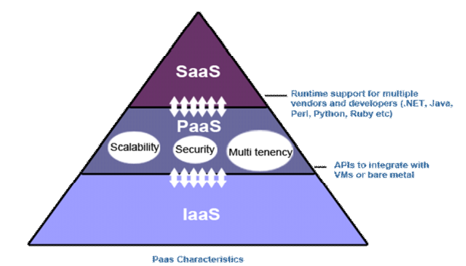
Platform as a Service (PaaS)
PaaS Characteristics

Slide 7
Platform as a Service (PaaS)
PaaS Characteristics
These environments need a way to monitor and measure resource usage and track the overall performance of the provider platform.
PaaS must offer some kind of development language so that professional developers (and in some cases common users) can add value.
Almost all PaaS platforms are based on a multi-tenancy architecture (which allows multiple clients to make copies separately from each other through virtualization) so that each customer's code or data is isolated from the others

Slide 8
Platform as a Service (PaaS)
PaaS example
A user wants to host a blog using Wordpress.
Basic requirement to run a Wordpress blog is LAMP (Linux, Apache, MySql, PHP and Perl) stack.
If the user wants to host it in the cloud, VM provided by cloud service provider must have a LAMP stack installed on it.
This type of VM with the required configuration is called web hosting platform and is delivered as a service.
The end user is responsible for installing Wordpress over the VM LAMP stack provided by CSP.
The user will also be responsible for maintaining and future patches and configuration of Wordpress.
CSP will maintain the VM LAMP stack as per the SLA agreed with the user.

Slide 9
Platform as a Service (PaaS)
PaaS example
force platform of the salesforce.com. Platform enables end user to build social app using social enterprise API provided by the platform.
A web hosting platform provided by yahoo on a subscription basis. The platform provide everything to host a website.

Slide 10
Platform as a Service (PaaS)
PaaS advantages
Cut coding time: PaaS development tools can cut the time it takes to code new apps with pre-coded application components built into the platform, such as workflow, directory services, security features, search, and so on.
Add development capabilities without adding staff. Platform as a Service components can give your development team new capabilities without your needing to add staff having the required skills.
Develop for multiple platforms—including mobile—more easily. Some service providers give you development options for multiple platforms, such as computers, mobile devices, and browsers making cross-platform apps quicker and easier to develop.
Use sophisticated tools affordably. A pay-as-you-go model makes it possible for individuals or organizations to use sophisticated development software and business intelligence and analytics tools that they could not afford to purchase outright.

Slide 11
Platform as a Service (PaaS)
PaaS advantages
Support geographically distributed development teams. Because the development environment is accessed over the Internet, development teams can work together on projects even when team members are in remote locations.
Efficiently manage the application lifecycle. PaaS provides all the capabilities that you need to support the complete web application lifecycle: building, testing, deploying, managing, and updating within the same integrated environment.

Slide 12
Integrated lifecycle platforms
Integration lifecycle platform is a set of automated tools that integrate software applications that are deployed in different environments. Large businesses that run enterprise-level systems often use it to integrate applications and data that live on premises and in both public and private clouds.
Integrated PaaS often comprise the following:
Collaboration tool
Programming language
Version Control
Tools to build web interaction
Operating System
Security
Development tools
A testing environment.
An ability to integrate databases.
A workflow engine (workflow engine allocates tasks to different executors while communicating data among participants).
Microsoft’s Azure and Google App Engine are the two widely held samples of integrated lifecycle platforms.

Slide 13
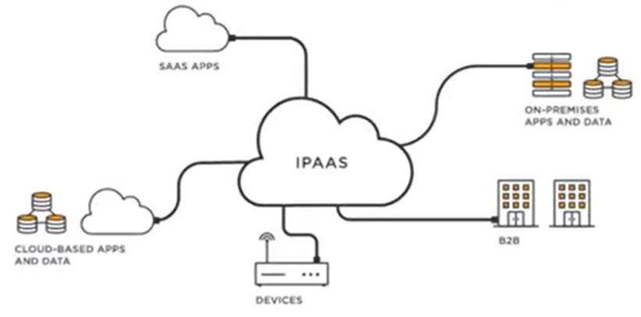
Platform as a Service (PaaS)
iPaaS (integrated Platform as a Service)
iPaaS, short for integration platform as a service, is a set of cloud services/tools used to connect software applications that are deployed in different environments.

Slide 14

Platform as a Service (PaaS)
iPaaS (integrated Platform as a Service)
This allows for faster integration and data sharing and removes barriers that IT teams normally face when new applications are added and allow for integration between cloud applications and even on-premise applications when combined with an API management solution.

Slide 15
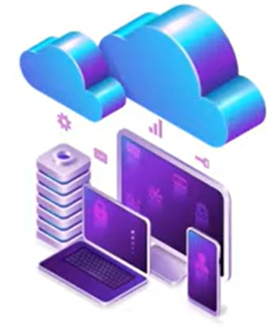
Platform as a Service (PaaS)
iPaaS (integrated Platform as a Service)
It connects disjointed s/w to provide a one step solution.
This framework enables communication across diverse systems and facilitate integration and data sharing.

Slide 16
Anchored lifecycle platforms
Anchored lifecycle platform is a continuous process that is used for managing an application in the major aspects of governance, development and operations throughout its life cycle.
An application’s life cycle starts from the conceptualization and ends with its removal when its business value has been outgrown or is no longer relevant.
Anchored platforms and integrated lifecycle platforms have almost similar characteristics, but there is a main key difference exists:
An integrated system provides a broad range of tools for integration, whereas an anchored system is based on complete development of the application.

Slide 17
Enabling technologies as a platform
Not all stack in the cloud comprises complete lifecycle environments. Some stack focus on providing specialized abilities. Some of these abilities can be a specific instrument.
Although Amazon.com offers a complete stack, IaaS also offers platform tools such as SimpleDB and Simple Query Service (SQS).
Other allowing technical environments (such as RightScale) designed for a management stack planned for the cloud.
Hyperic is a division of spring source (an acquired VMWare), offers a cloud-based monitoring environment.
WaveMaker allows users to customize their platform and allows developers to reuse existing code within the PaaS environment.

Slide 18
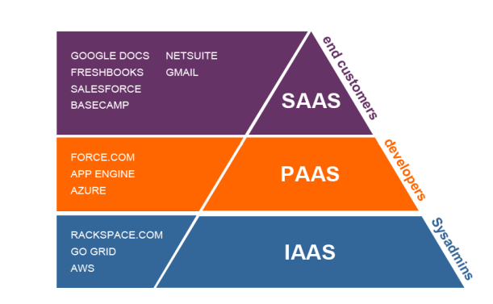

Slide 19
PaaS is best suited
If multiple developers are functioning on a growing project and if other exterior organizations want to cooperate with the development procedure, then in such situations PaaS will be extremely useful.
PaaS will also be useful in situations wherein the developers desire to automate deployment and testing services.

Slide 20
PaaS is not best suited
PaaS may not be the best option for few situations, examples include:
Wherein the development process will get affected because of proprietary languages.
In a situation wherein the application performance requires customization of the underlying software and hardware.

